Slide 1

RC Quick Byte: Maximizing Efficiency Using Parallelization

Slide 2

Maximizing Efficiency Using Parallelization
Date: March 5, 2025
Instructor: Andrew Monaghan
Contributors: Layla Freeborn, Trevor Hall, Brandon Reyes, Shelley Knuth
Website: www.rc.colorado.edu/rc
Documentation: https://curc.readthedocs.io
Helpdesk: rc-help@colorado.edu
Survey: http://tinyurl.com/curc-survey18
Slides
https://github.com/ResearchComputing/max_efficiency_parallel_quick_byte

Slide 3
Learning Objectives and Outline
What is parallelization?
Types of parallelization
Is parallelization for me?

Slide 4

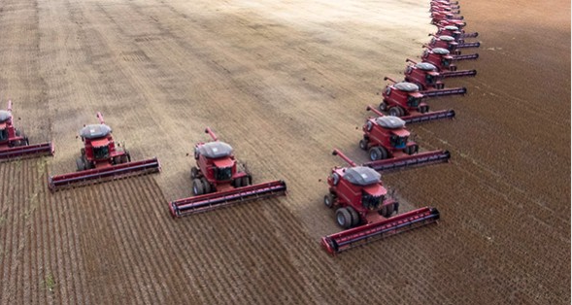
What is parallelization?
Serial
Parallel
Image source: https://www.freepic.com
Image source: https://bxjmag.com

Slide 5
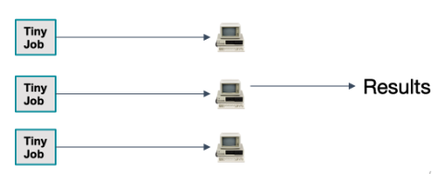
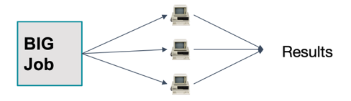
Types of parallelization
Code-external parallelization
Code-internal parallelization
Example: Image processing
Example: Climate Model

Slide 6
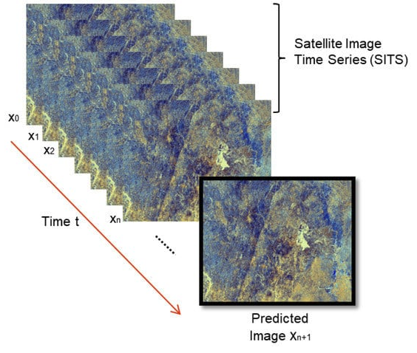
Code-external parallelization
Also referred to as:
HTC: High throughput computing
“Embarrassingly” parallel computing
Used for repetitive, independent tasks
Processing images from satellites, microscopes
Monte Carlo-type statistical modeling
CURC has lots of tools to facilitate HTC!
https://github.com/ResearchComputing/easy_parallelization_htc_primer
Image source: https://www.mdpi.com/journal/remotesensing/special_issues/AI_rs

Slide 7
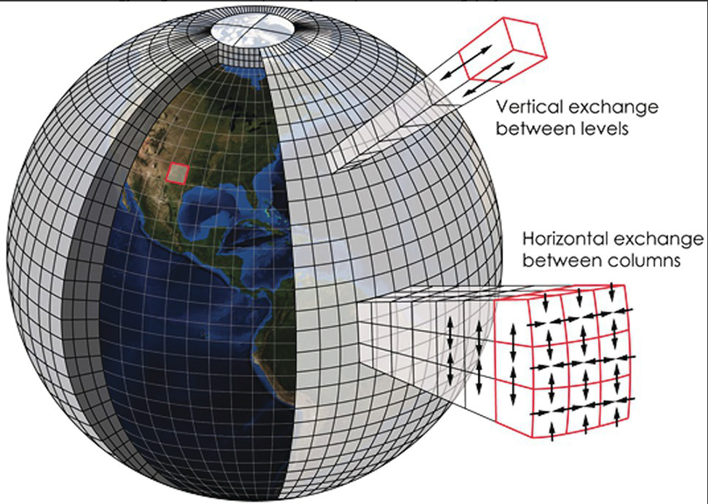
Code-internal parallelization
Types:
Shared-memory (“multithreading”)– single node (computer)
Distributed-memory (“multiprocessing or “MPI”) – multiple nodes
Accelerated -- GPUs
Used for dependent, independent tasks
Climate or earthquake simulations (PDEs)
Machine learning (GPUs)
CURC supports all types of code-internal parallelization!
Image source: www.earthmagazine.org/article/todays-weather-forecast-good-strong-chance-improvement
Information source: https://researchcomputing.princeton.edu/support/knowledge-base/parallel-code

Slide 8
Additional topics (if time allows)
Is parallelization for me?
Computational time constraints?
Computational memory constraints?
Level of effort to parallelize?
How do I get started with parallelization?
Look for existing code!
Consult with your Research Computing staff

Slide 9

Thank you!
http://tinyurl.com/curc-survey18
Survey and feedback

